Slide 1
http://www.vidyanidhi.com/
ketkiacharya.net@gmail.com
Ketki Acharya
From: SM VITA ATC of CDAC
ketkiacharya.net@gmail.com

Slide 2
REST (Representational State Transfer)
REST is an architectural style that dictates to think in terms of resources and their representation instead of just thinking about methods within a system.
REST architecture focuses almost on the same set of constraints like Uniform interface, separation of concerns, caching, statelessness etc. as other distributed architecture follow.
Using REST, we get the following advantages:
is an architectural style that dictates to think in terms of resources and their representation instead of just thinking about methods within a system. REST architecture focuses almost on the same set of constraints like Uniform interface, separation of concerns, caching, statelessness etc. as other distributed architecture follow. Using REST, we get the following advantages:
REST also means using HTTP the way it meant to be. But a simple WCF service uses HTTP only as a transport, although HTTP is much more than just a transport. HTTP is already designed in the way as RESTful architecture suggests.
RESTful services are also referred as HTTP services because HTTP also focuses on interaction between resources and their representation

Slide 3
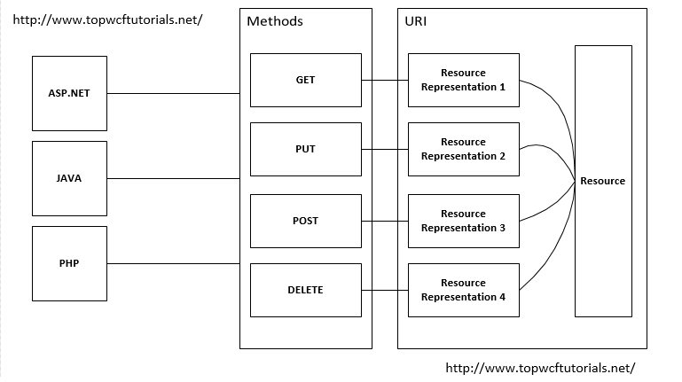
HTTP is the standard protocol for the all communication between resources over the Web. So, it defines various methods for interaction with resources as follows:
GET:- means requesting a specific representation of a resource.
PUT:- means creating or updating a resource with a provided representation.
DELETE:- simply defines, deleting the specific resource.
POST:- defines submitting data to be processed by the identified resource.
HEAD:- is similar to GET but only retrieve header not the body.

Slide 4
Why Rest
WCF service will allows to make calls and exchange the data using SOAP protocol over different protocols (HTTP, TCP, MSMQ etc..) and it uses the complex mechanism like SOAP for communication.
The REST service is simple to use it uses the HTTP protocol for all operations, its lightweight and faster, it uses the .json and .xml formats.
MSMQ is Microsoft Message Queuing developed by Microsoft and deployed in windows operating system. MSMQ Queue ensures that reliable messaging between a client and a Windows Communication Foundation (WCF) service.
NetTcpBinding can be useful where IIS services are not needed. Ie for DeskTop Application [Intra net]
netNamedPipeBinding
This binding is used to provide secure and reliable Named Pipe based communication between WCF services and WCF client on the same machine. It is the ideal choice for communication between processes on the same machine.
netPeerTcpBinding
This type of binding exists to cater peer-to-peer computing using WCF services.

Slide 5
WCF
Http
TCP
Web Application
Desktop Application

Slide 6
Thumb rules in choosing endpoint' binding
If you require your service to be consumed by clients compatible with SOAP 1.1, use basicHttpBinding for interoperability
If you require your service to be consumed within the corporate network, use netTCPBinding for performance
If you require your service to be consumed over the internet and the client is a WCF compatible, use wsHttpBinding to reap full benefits of WS* specifications
If you require your service to be accessible only in the same machine, use netNamedPipeBinding
If you require your service to be queue messages, use netMsmqBinding
If you require your service to act as server as well as client in a peer to peer environment, utilise netPeerTcpBinding setting
Binding | Security Default Configurable | Transport Protocol | Encoding Default Other | Host
basicHttpBinding | None, Transport, Message, Mixed | HTTP | Text/XML, MTOM | IIS, WAS
wsHttpBinding | Message, Transport, Mixed | HTTP | Text/XML, MTOM | IIS, WAS
netTcpBinding | Transport, Message, Mixed | TCP | Binary | WAS
netNamedPipeBinding | Transport,None | Named Pipe | Binary | WAS
netMsmqBinding | Message, Transport, None | TCP | Binary | WAS
netPeerTcpBinding | Transport | P2P | Binary | -
Message Transmission Optimization Mechanism (MTOM)
Message Transmission Optimization Mechanism (MTOM)

Slide 7
Criteria | BasicHttpBinding | WsHttpBinding
Security support | This supports the old ASMX style, i.e., WS-BasicProfile 1.1. | This exposes web services using WS-* specifications.
Compatibility | This is aimed for clients who do not have .NET 3.0 installed and it supports wider ranges of clients. Many of the clients like Windows 2000 still do not run .NET 3.0. So an older version of .NET can consume this service. | As it is built using WS-* specifications, it does not support wider ranges of clients and it cannot be consumed by older .NET versions less than 3 version.
SOAP version | SOAP 1.1 | SOAP 1.2 and WS-Addressing specification.
Reliable messaging | Not supported. In other words, if a client fires two or three calls you really do not know if they will return back in the same order. | Supported as it supports WS-* specifications.
Default security options | By default, there is no security provided for messages when the client calls happen. In other words, data is sent as plain text. | As WsHttBinding supports WS-*, it has WS-Security enabled by default. So the data is not sent in plain text. But encrypted
Security options | None Windows – default authentication Basic Certificate | None Transport Message Transport with message credentials

Slide 8
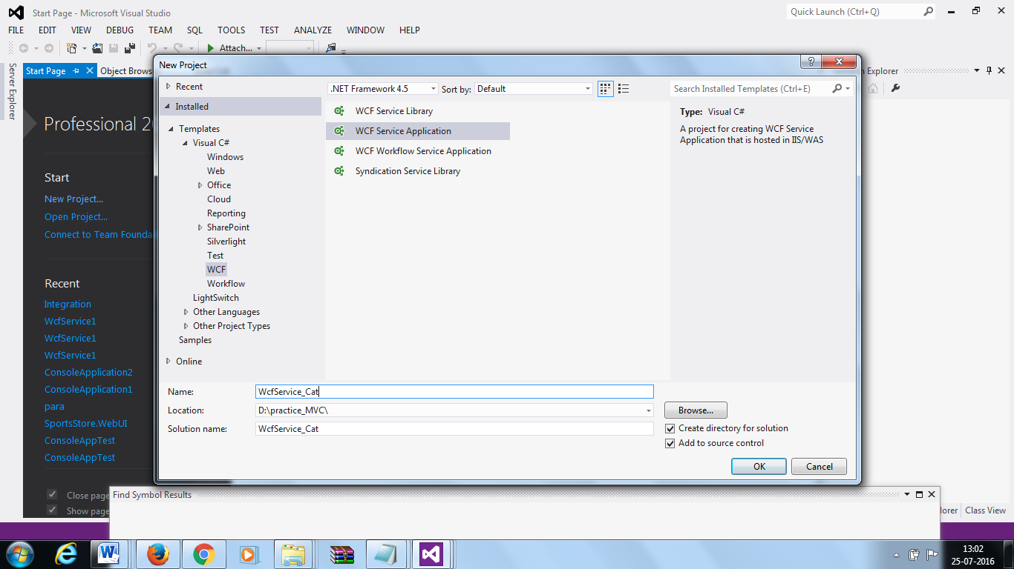
WCF REST API HTTP binding How to start

Slide 9
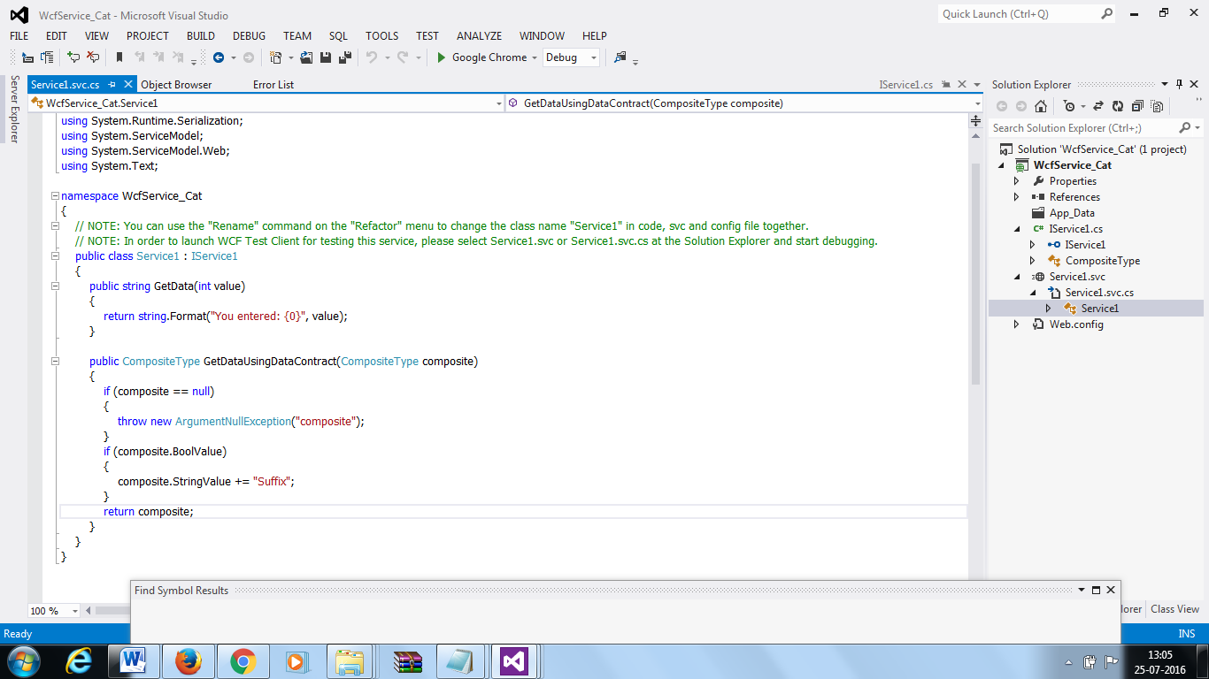
Modify the file Service1.SVC. --What is SVC?
A .svc file contains a WCF-specific processing directive (@ServiceHost) that allows the WCF hosting infrastructure to activate hosted services in response to incoming messages. The most common syntax for a .svc file is in the following statement.
<% @ServiceHost Service="MyNamespace.MyServiceImplementationTypeName" %>
It consists of the @ServiceHost directive and a single attribute, Service

Slide 10
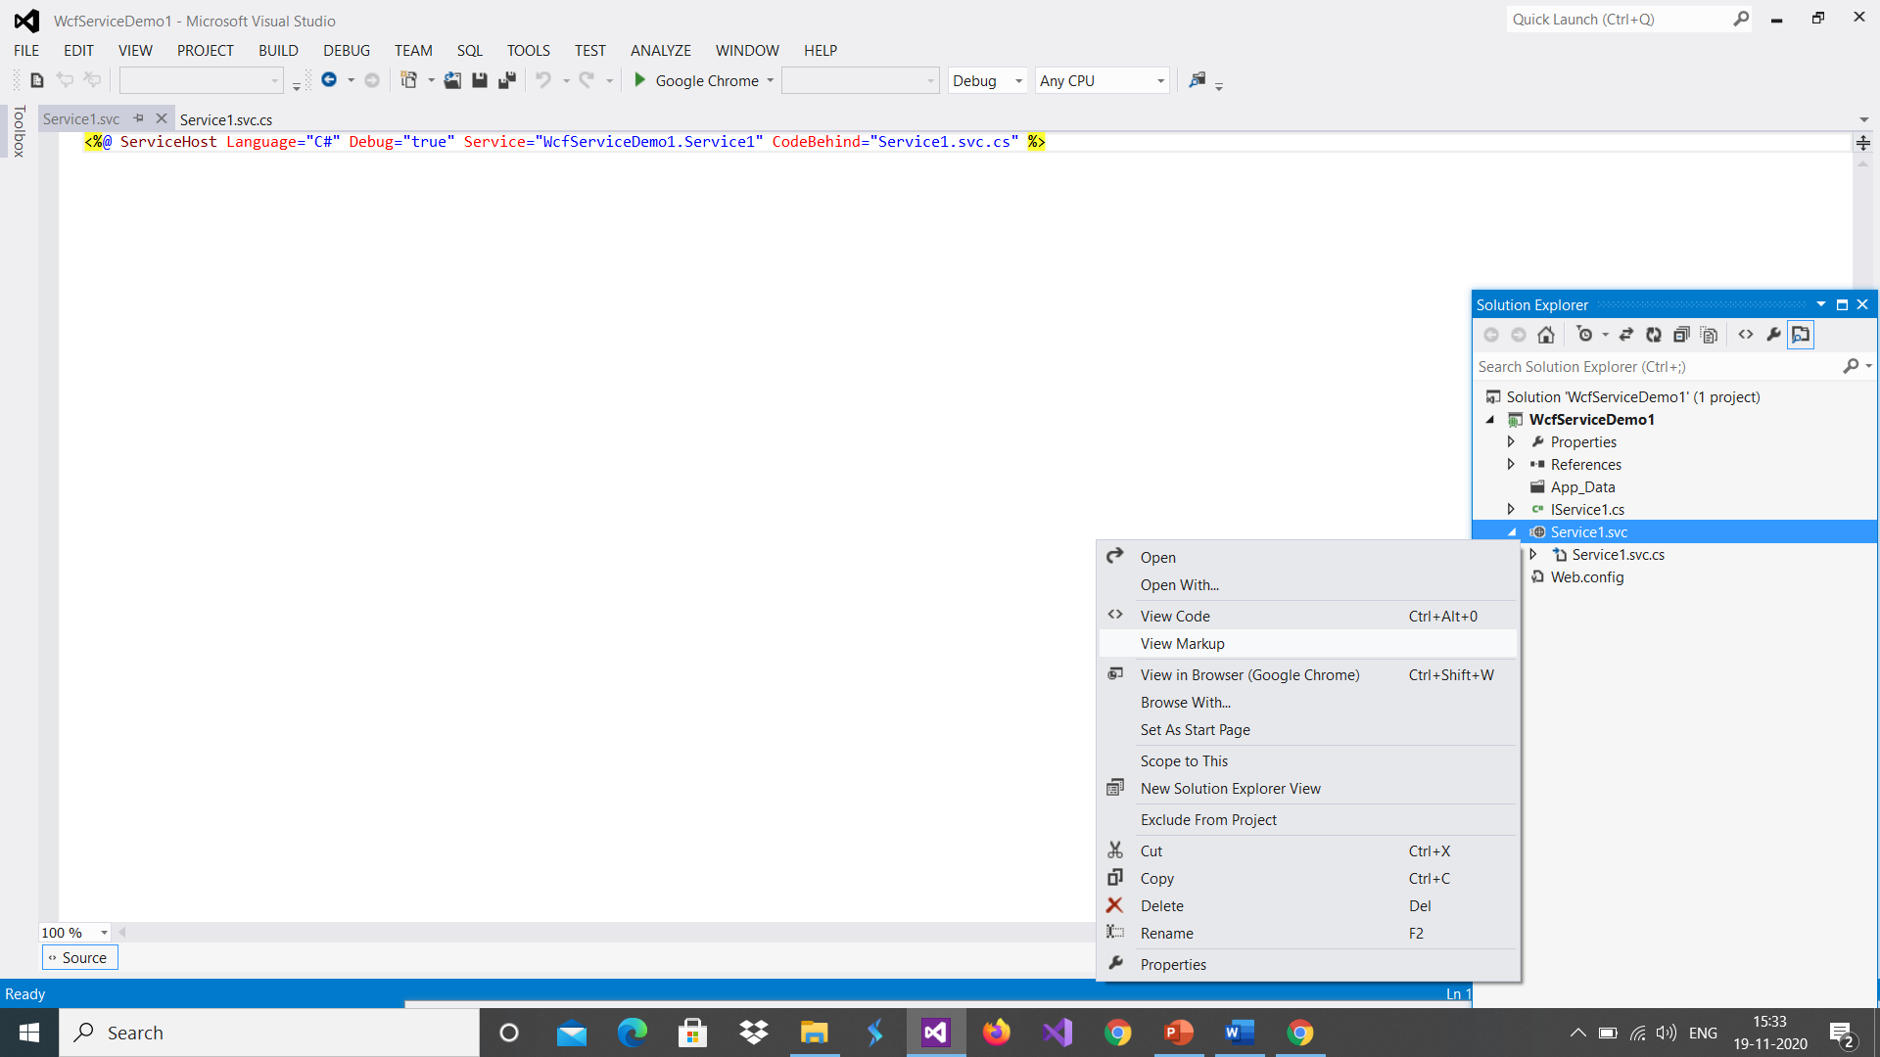
How to see markup

Slide 11
Delete method From Service1.svc.cs
Aslo delete such code from IService1 Interface

Slide 12
Service Contract and Operation Contract
A Service Contract basically describes the operations a service exposes to another party (in other words a client). We can map a WCF Service Contract to a Web Service Description Language (WSDL).
It's recommended to apply the ServiceContract attribute to an interface, although it can be applied to a class as well. Applying it to an interface provides us a clear separation of contract and its implementation.
It describes:
What operations are exposed by the service
Platform independent description of the interface as well as methods of our service
A Message Exchange Pattern (MEP) between the parties, in other words Request/Response, One-Way or Duplex. Please follow here for a detailed description of MEPs.

Slide 13
Open ISevice1 Add Attribute WebInvoke
[ServiceContract]
public interface IService1
{
[OperationContract]
[WebInvoke(Method = "GET", ResponseFormat = WebMessageFormat.Json,
BodyStyle = WebMessageBodyStyle.Bare,
UriTemplate = "GetData/")]
string GetData();
}
WebInvoke indicating that a service operation is logically an invoke operation and that it can be called by the WCF REST programming model.
The WebInvokeAttribute attribute is applied to a service operation in addition to the OperationContractAttribute and associates the operation with a UriTemplate as well as an underlying transport verb that represents an invocation (for example, HTTP POST, PUT, or DELETE).
The WebInvokeAttribute attribute is a passive operation behavior (the IOperationBehavior methods do nothing) that adds metadata to the operation description.

Slide 14
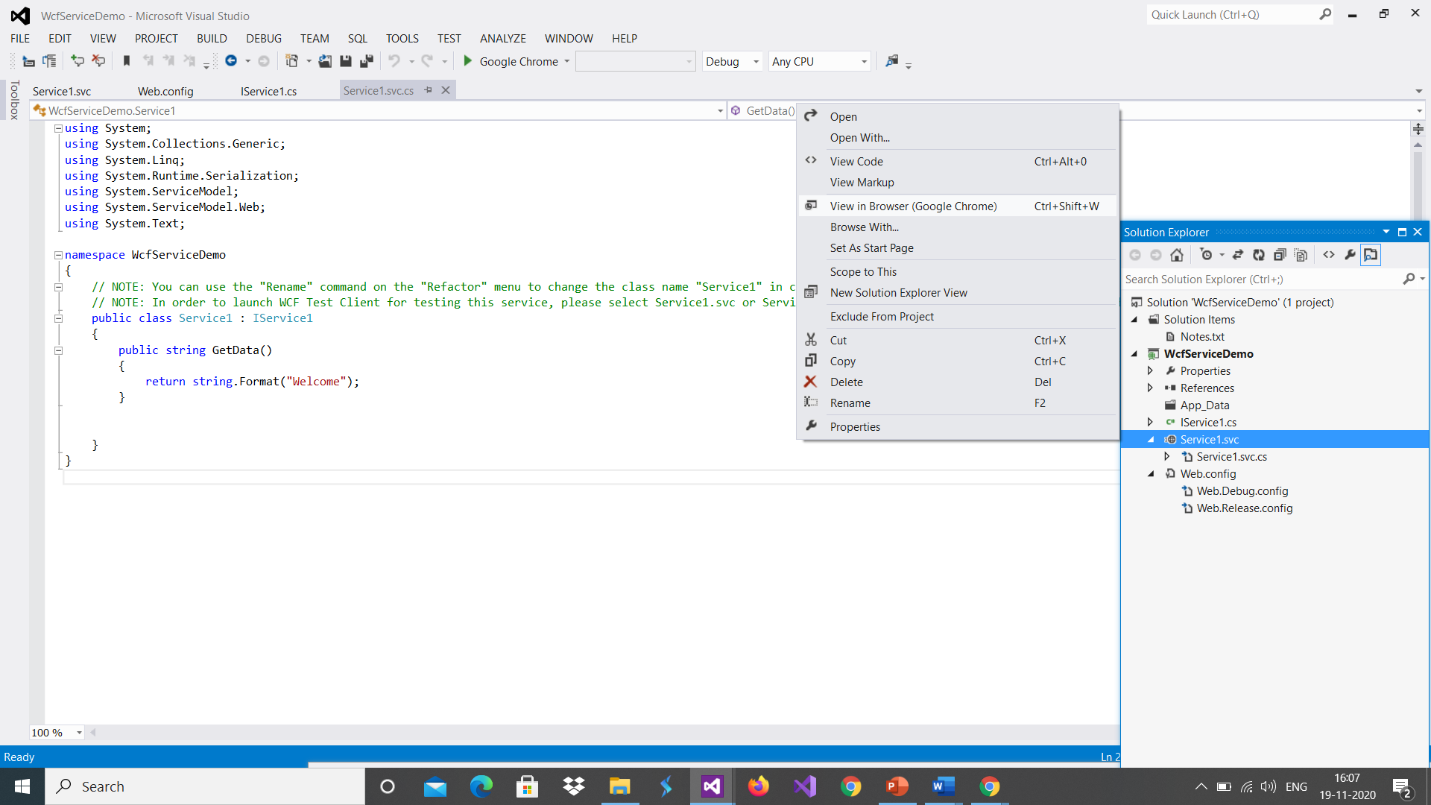
Right click on SVC file and click View in Browser

Slide 15
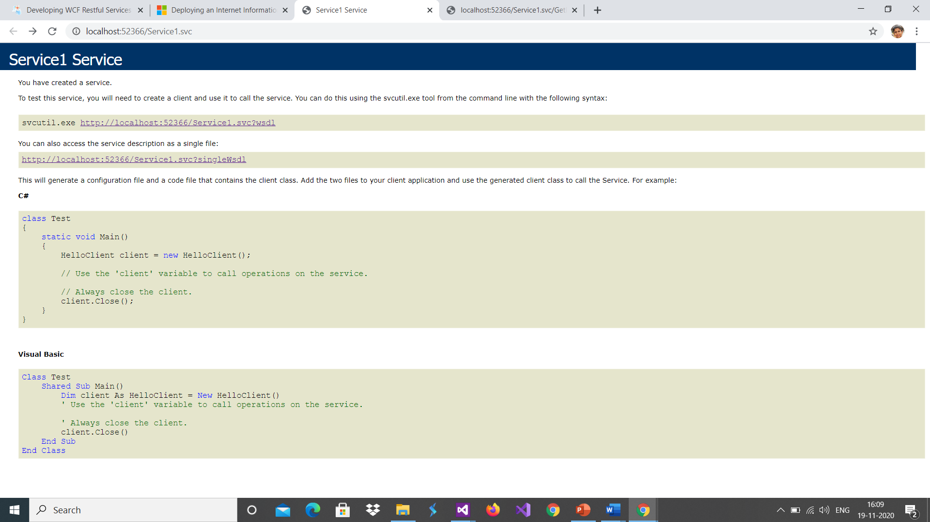
This indicate your service is running

Slide 16
Open another browser and type
Copy service URL in this new browser
And call method
http://localhost:52366/Service1.svc/GetData
Your rest service is ready returning a string

Slide 17
System.ServiceModel.Web Namespace
Provides classes related to using the service model on the web.
System.ServiceModel Namespace
Provides classes related to the service model.
WebHttpBinding Class
A binding used to configure endpoints for Windows Communication Foundation (WCF) Web services that are exposed through HTTP requests instead of SOAP messages.
The WCF Web Programming Model allows developers to expose WCF Web services through HTTP requests that use "plain old XML" (POX) style messaging instead of SOAP-based messaging. For clients to communicate with a service using HTTP requests, an endpoint of the service must be configured with the WebHttpBinding that has the WebHttpBehavior attached to it. The WCF Web Programming Model also requires that the individual service operations are annotated with the WebGetAttribute or WebInvokeAttribute attributes. This defines a mapping from a URI and HTTP method to the service operation, as well as the format of the messages used to call the operation and return the results.

Slide 18
If you do not modify class name and interface name then no need to modify Web.config .
But if you modify then you have to update ABC of WCF
After <system.serviceModel> tag put up following line

Slide 19
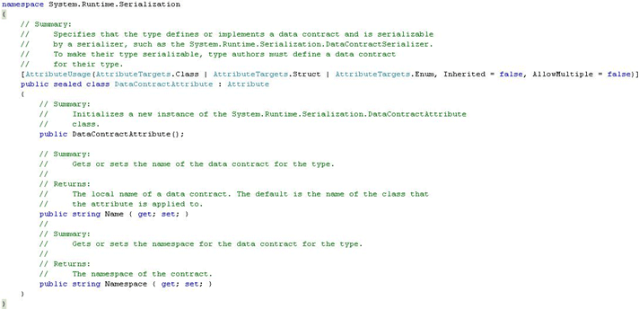
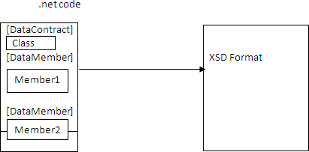
What is Data Contract DataMember
DataContract is under namespace System.Runtime.Serialization. During design time, DataContract Attribute is used to indicate which class should be represented as XSD.
DataMember Attribute indicates which class member to be used in external representation.

Slide 20
DataContract Property | Description
Namespace | It is used to get or set the namespace for the DataContract attribute of this type.
Name | It is used to get or set the name for DataContract attribute of this type.
DataMember Property | Description
Order | It is used to get or set the order of serialization and deserialization of a member.
ISRequired | It instructs the serialization engine that member must be present while reading or deserializing.
Name | It gets or sets the DataMember name.
EmitDefaultValue | It will specify whether the default value to be serialized.
The Data Contract Serializer will serialize all public properties of your complex type in an alphabetical order. By default private field and properties are not serialized.
if we decorate a complex type, with [Serializable] attribute the DataContractSerializer it serialized all fields. with [Serializable] attribute we don't have explicit control on what fields to include and exclude in serialized data.
Using System.Runtime.Serialization if we decorate a complex type with [DataContract] attribute the DataContractSerializer serializes the field marked with the [DataMember]attribute. The field that are not marked with [DataMember] attribute are exclued from serialization.
The [DataMember]attribute can be applied either on the private fields or public properties. in WCF, the most common way of serialization is to mark type with the DataContract attribute and marked each member that needs to be serialized with the DataMember attribute

Slide 21
Lets discuss demo
D:\dot_net\Day_wise\Day17WCF_restAPI\01MyRESTService_final

Slide 22
In all service by default get is enabled ie. you can ask for data from server
If you have to post data on server then you have to configured server to allow user to post data on server.
To enable POST you have to write code in global.asax file. Do nor forget to save and rebuild application
protected void Application_BeginRequest(object sender, EventArgs e)
{
HttpContext.Current.Response.AddHeader("Access-Control-Allow-Origin", "http://localhost:56606");
if (HttpContext.Current.Request.HttpMethod == "OPTIONS")
{
HttpContext.Current.Response.AddHeader("Access-Control-Allow-Methods", "POST, PUT, DELETE");
HttpContext.Current.Response.AddHeader("Access-Control-Allow-Headers", "Content-Type, Accept");
HttpContext.Current.Response.AddHeader("Access-Control-Max-Age", "1728000");
HttpContext.Current.Response.End();
}
}

Slide 23
Lets discuss demo
D:\dot_net\Day_wise\Day17WCF_restAPI\02postglobal\WcfServicepost
For this we have to install postmen app Software

Slide 24
